Slide 1
Machine Tools

Slide 2
Manufacturing Process
It is a process which involves the conversion of raw materials into desired product.
Types:
Additive Manufacturing Process
Material Removal Process
Methods involved:
Material Removal
Assembling and joining process
Finishing Process

Slide 3
Machine Tools
A machine tool is a device use to carry out various manufacturing operation by removing the excess material.
Tools
Machine tools
Hand tools
Notes:
Power driven cutting tools

Slide 4
Types of tools
Hand tools
Manual work involved.
Fitting tools
Hacksaw
Files
Chisels
Craft tools
Scissors
blade
Machine tools
Work is done by machines.
Lathe
Drilling
Tapping
Milling
Grinding

Slide 5
Lathe:
A lathe is a machine tool generally used to produce circular objects where a cutting tool is fed against the rotating work piece to remove excess material.
Operations carried on lathe:
Drilling
Grinding
Shaping
Milling
Notes:
Types of lathe
Engine , turret , speed, capstan, automatic , CNC
Engine lathe( it is a machine driven by prime mover used to produce circular objects), center lathe or simply called as lathe – machine shop
A machine tool used to remove excess material by forcing a cutting tool against a rotating work piece.

Slide 6
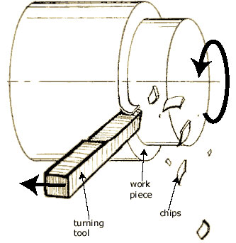
What is Lathe……?
Lathe- A machine tool used to remove excess material by forcing a cutting tool against a rotating work piece.
Principal- A Cutting tool can remove material when moved against a rotating work piece….
Material is removed from the W/p in the form of Chips, and surface produced depend upon the movement of the tool
Notes:
Lathe is one of the most widely used machine tools in metal cutting work.
Lathe is usually used for machining (metal removal) the job which is rotated and a cutting tool is fed to cause the cutting action.
Lathe is generally used for machining cylindrical jobs.
The work piece is hold firmly in the work holding device called the chuck and is supported by the dead center as shown in the fig.above
The chuck is rotated at a particular speed by some mechanisms; the cutting tool is moved against the rotating work piece to facilitate the removal of material.

Slide 7
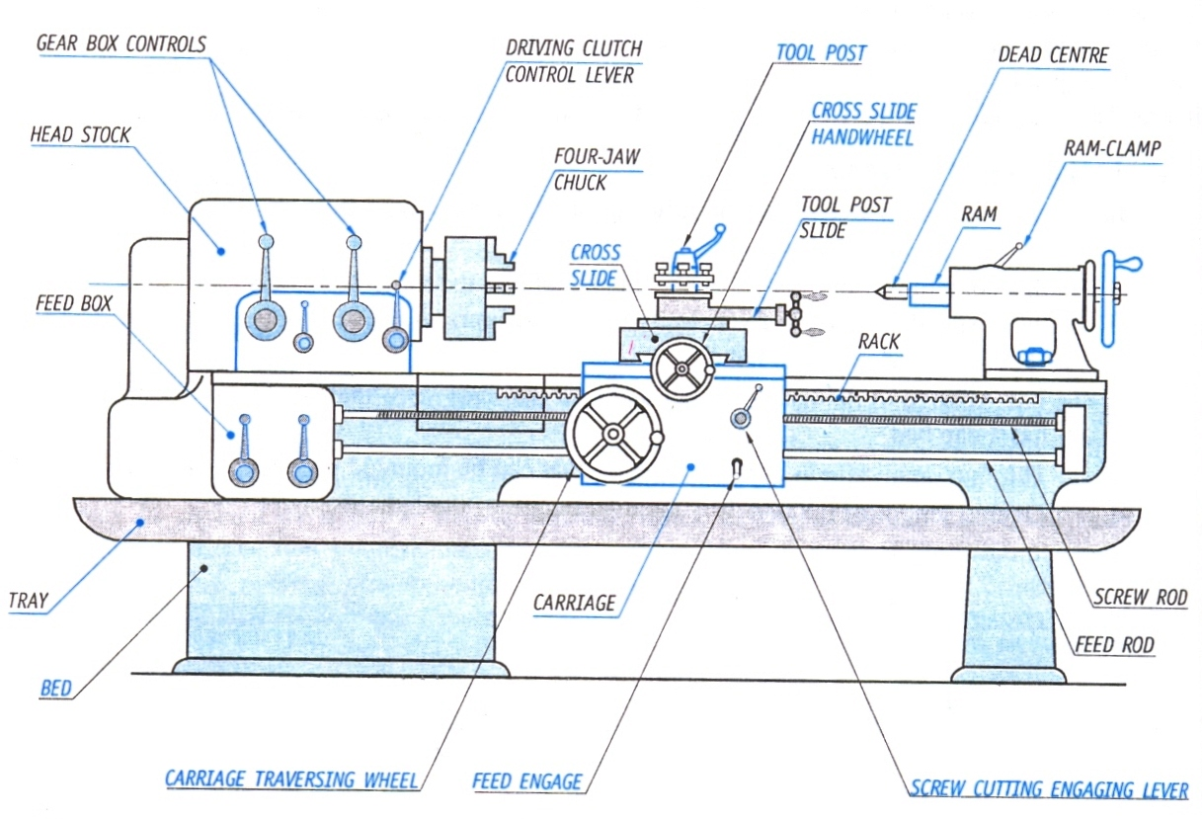
Lathe:
Notes:
The work piece is hold firmly in the work holding device called the chuck (live center) and is supported by the dead center as shown in the fig.above
The chuck is rotated at a particular speed by some mechanisms; the cutting tool is moved against the rotating work piece to facilitate the removal of material.

Slide 8
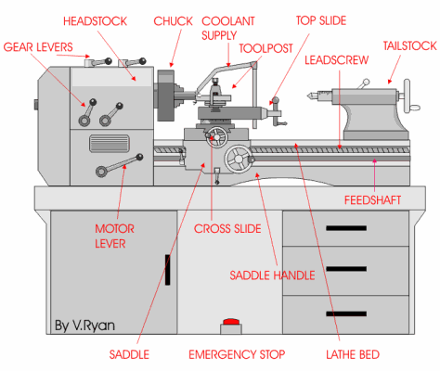
Parts of Lathe
compound Rest
Carriage
LATHE

Slide 9
BED – Made Grey CI- Provided with Guide ways for accurate moment of carriage and tail stock
HEADSTOCK – Gears and Pulleys – Spindle and chuck to support W/P
TAILSTOCK – Support for other end of W/P – Tool Holder
CARRIAGE
Saddle – Slides along the Bed-ways
Cross-slide – Mounted on saddle and allows cutting tool to provide necessary DOC (Depth of Cut)
Compound rest – Has Circular base graduated in degrees( tool can be swivelled to any angle to obtain taper surfaces
Tool-Post- Mounted on compound rest, holds and supports cutting tool
Feed rod – Long shaft that gives automatic feed for carriage
Lead screw – Long Shaft with square threads cut on it (helps in movement of carriage in thread cutting operations)

Slide 10
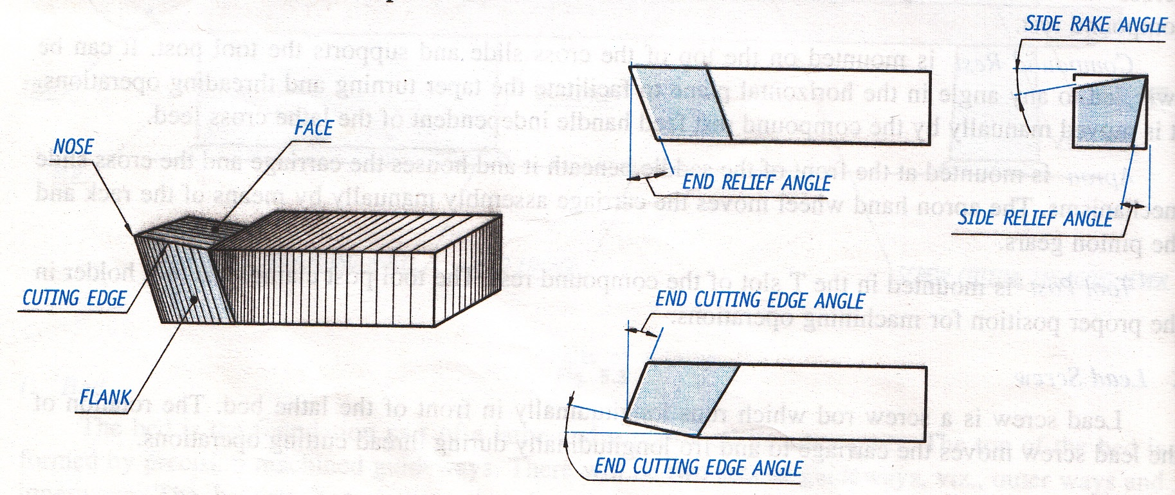
Cutting Tool
Notes:
This is a single point cutting tool used to remove the material from the workpiece
Cutting edge it is a part of tool that does the actual cutting of metal
Flank is a tapered surface below the cutting edge
Face is a top of the tool where chips will glides over it and passes way from the workpice
Relief or clearance angles are ground on both the end and side faces of a tool to prevent it from rubbing on the workpiece. It enables only cutting edges to touch the workpiece.
Rake angles are ground on the tool to prevent a smooth flow of chips over tool bit so as to move it away from workpiece.

Slide 11
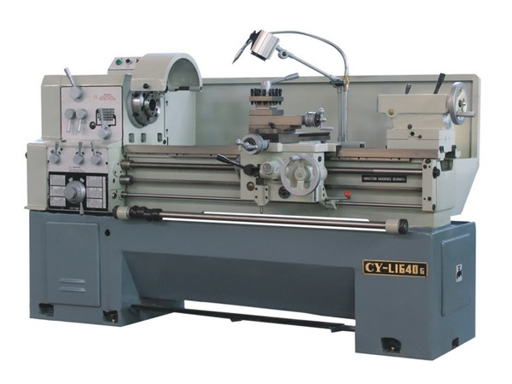
Lathe Classification
Speed Lathe
Called so because of high spindle speeds
Preferred in wood working, polishing, where Light cuts are to be made on a work pieces.

Slide 12
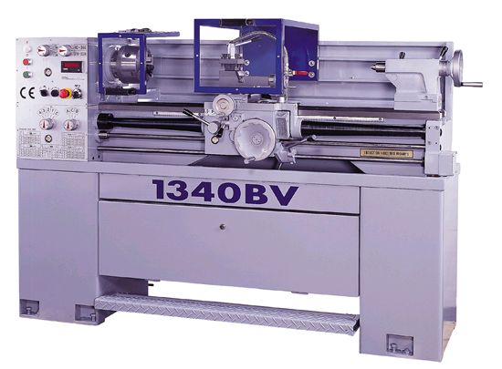
Bench Lathe
Small sized lathe, usually mounted on a bench
Its small size makes it suitable for machining precision work

Slide 13
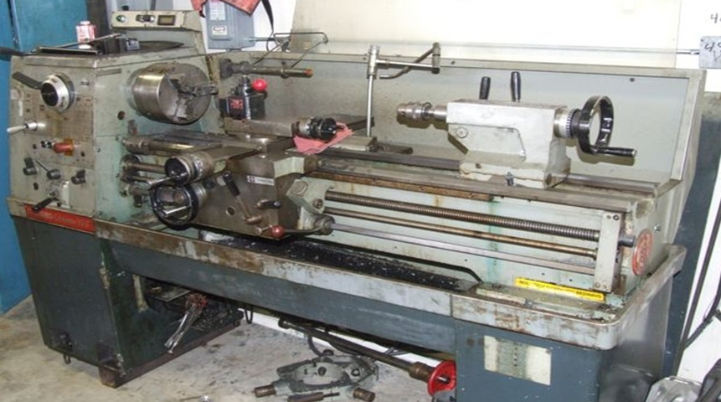
Tool room Lathe
Equipped with some extra attachments to make it suitable for more accurate and precision type of work…ex production of tools, dies, gauges, fixtures etc

Slide 14
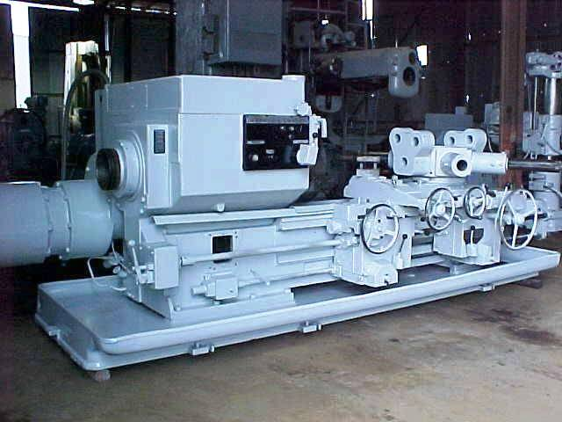
Capstan and Turret Lathe
Production machines, usually semi automatic type.
The tool post can carry around 6-12 different tools for different operations.
Used in mass production

Slide 15
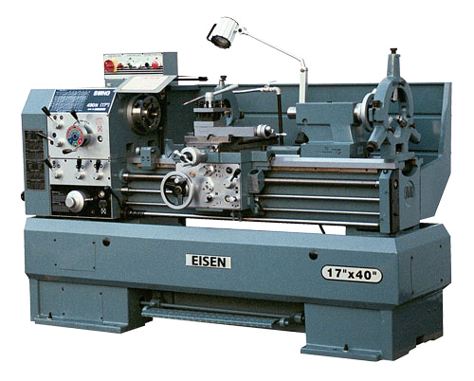
Engine Lathe

Slide 16
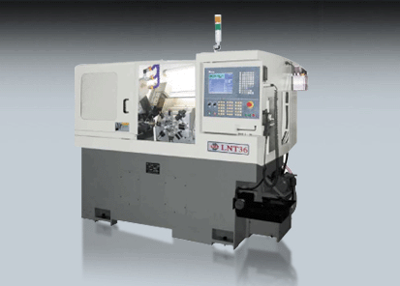
Automatic Lathe

Slide 17
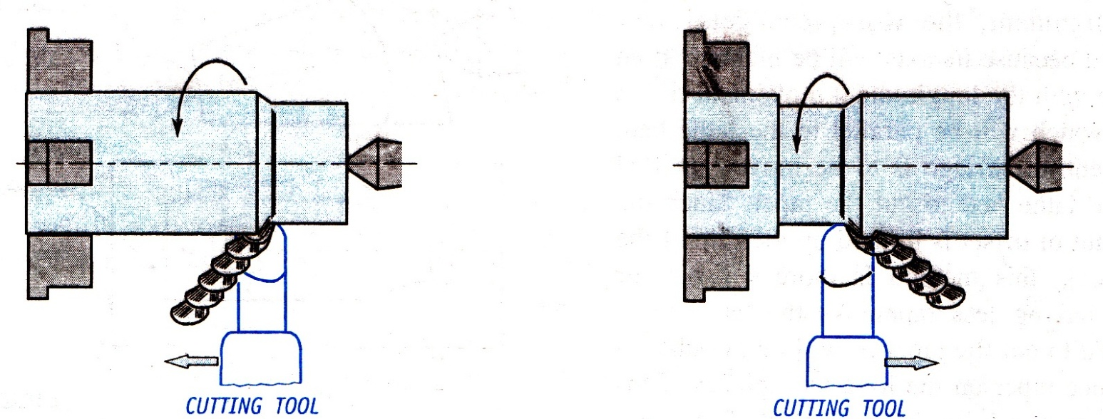
Lathe Operations - Turning
It is an operation in which the workpiece is reduced to the cylindrical section of required diameter.
Operation is carried out with a single point cutting tool.
Work piece is supported between the two centers permit rotation of workpiece.
The tool feed is moved parallel to the axis of the lathe to perform turning.
Notes:
Turning (cylindrical turning, plain turning, straight turning) can be done through rough turning and finish turning.
In rough turning the excess material from workpiece is removed rapidly by giving high dept of cut with fast feed rate
In finish turning excess material is removed by giving light depth of cut and small feed.

Slide 18
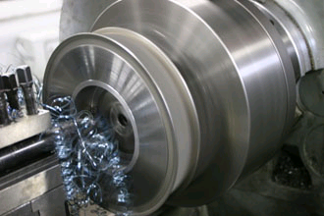
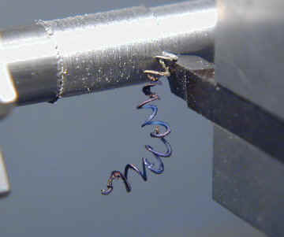
CYLINDRICAL TURNING – Operation of removing excess material from the work piece to produce a cylindrical surface.

Slide 19
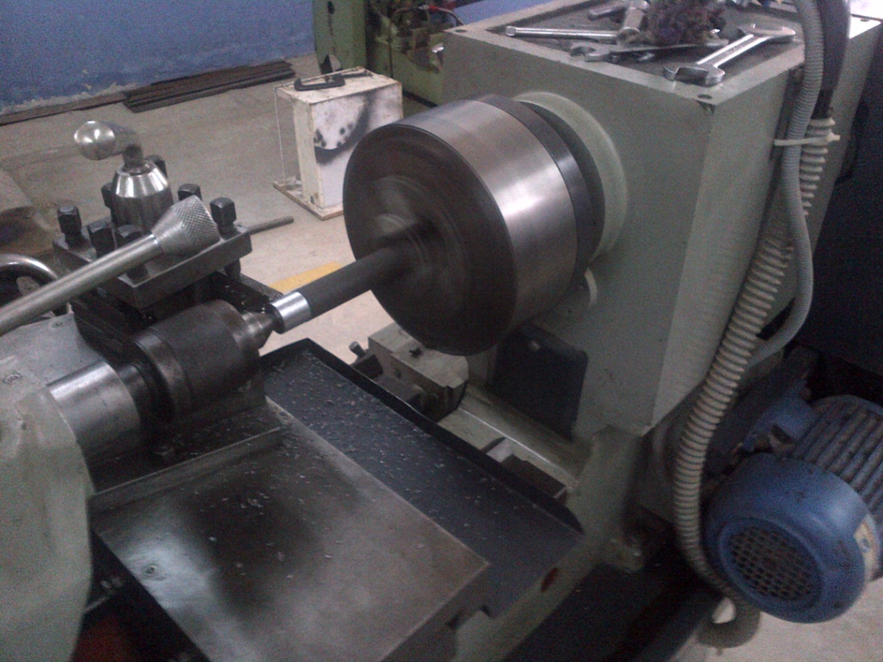
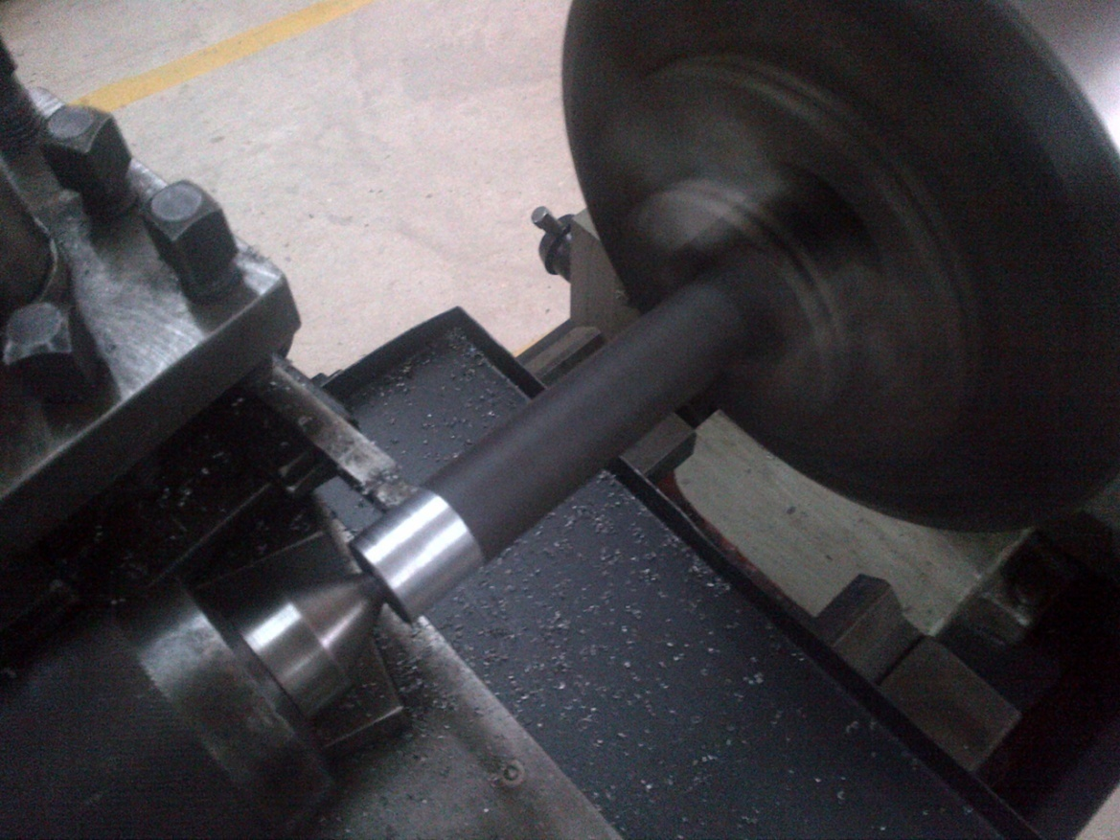

Slide 20
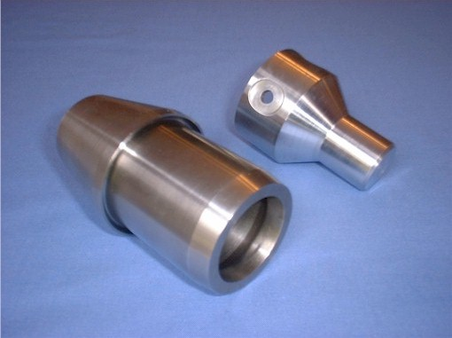
Lathe Operations – Taper Turning
It is the operation of reducing the diameter of the workpiece gradually along its length.
Notes:
Taper turning is a process of producing a conical surface from a cylindrical shaped workpiece. A taper is produced when the cutting tool moves at an angle to the axis.

Slide 21
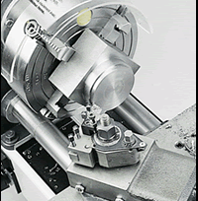
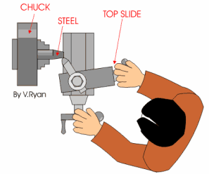
TAPER TURNING – Operation of producing a conical surface from a cylindrical shaped work piece. It can be produced by
1) Swiveling of compound rest 2) Off – setting the tail stock
3) Using taper turning attachments

Slide 22
Taper Turning by Swiveling the Compound Rest
In this method the job is rotated on the lathe axis.
Tool feeding is done at an angle, by the swiveled compound rest.
To assist in swiveling at particular angle, the base of the compound rest is graduated in degrees.

Slide 23
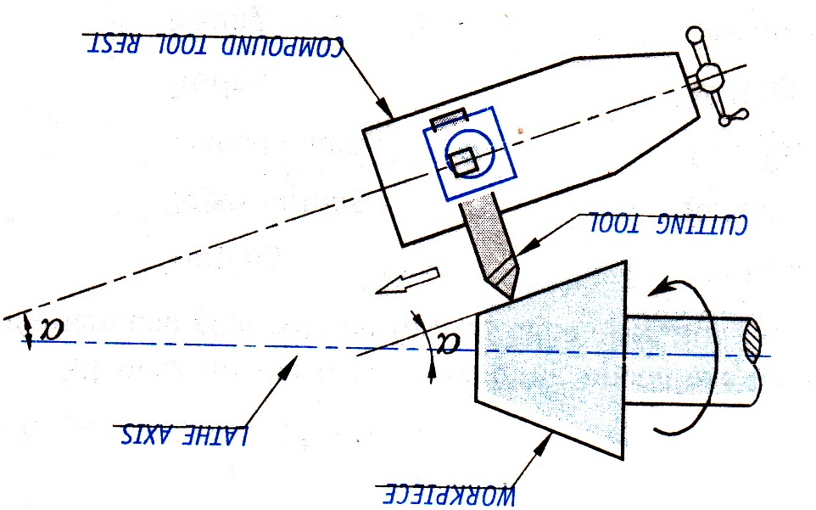
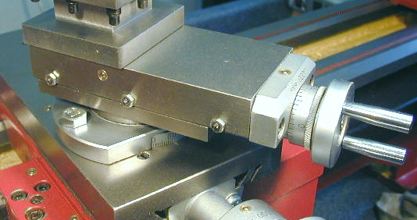
Taper Turning by Swiveling the Compound Rest

Slide 24
Taper Turning by Swiveling the Compound Rest
Taper angle: Angle at which the compound rest to be rotated is calculated as below.
tan α =
α = half taper angle
D = larger diameter of the taper in mm.
d = smaller diameter of the taper in mm.
L = length of the taper in mm.
The tool feeding is done only by the compound rest hand wheel so that the tool moves at the set angle only.

Slide 25
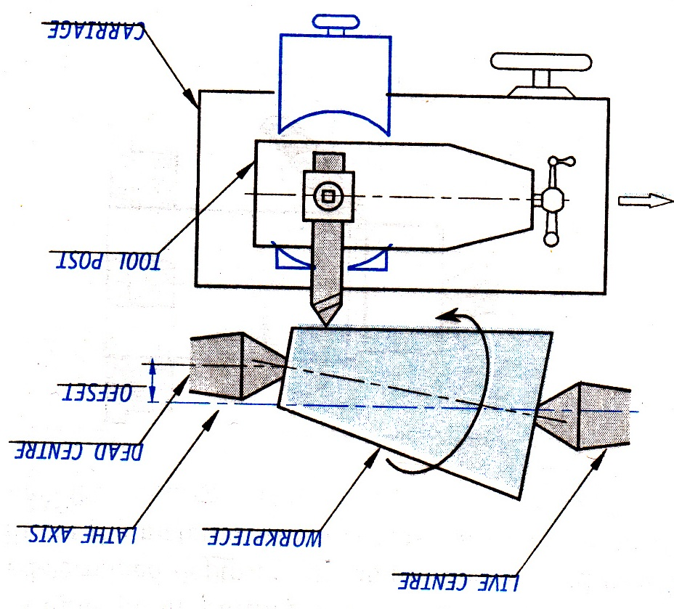
Taper Turning
Notes:
Tailstock offset

Slide 26
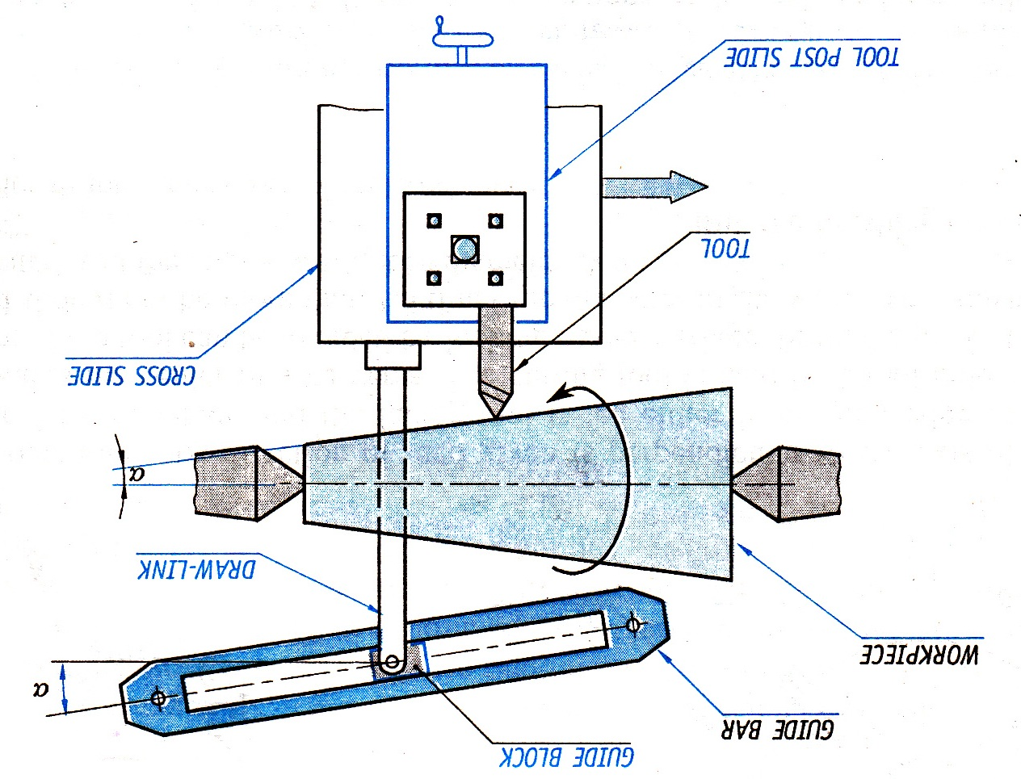
Taper Turning

Slide 27
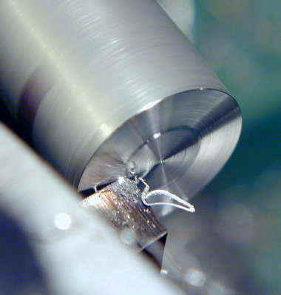
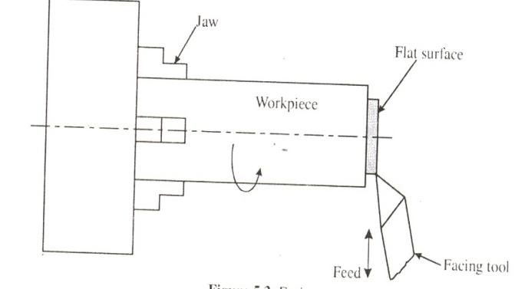
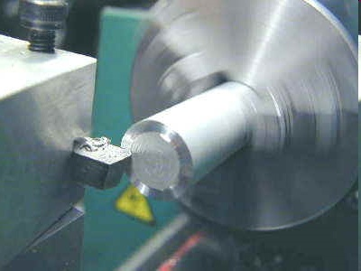
Lathe Operations – Facing
An operation performed on lathe to generate flat surface.
Direction of feed is perpendicular to the axis of the lathe.
Notes:
In this process one end of workpiece is held rigidly in the chuck, while the other is left unsupported .
Facing is also carried out to reduce or cut the workpiece to the required length.

Slide 28
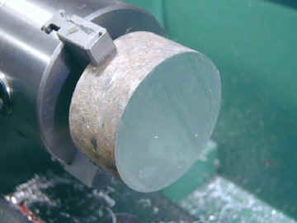
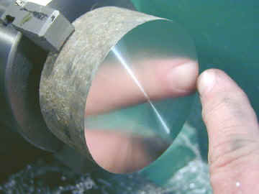
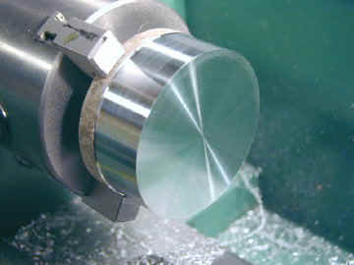
FACING – Operation for generating flat surfaces at the end of the job.

Slide 29
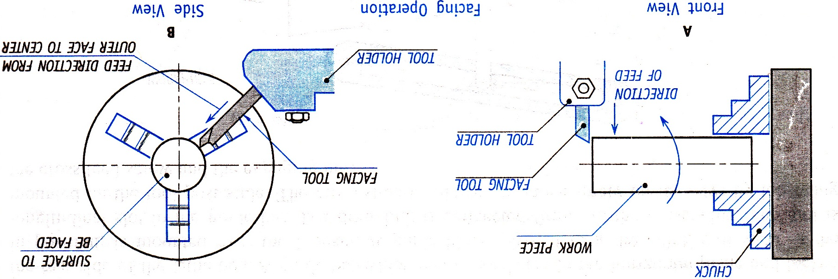
Facing

Slide 30
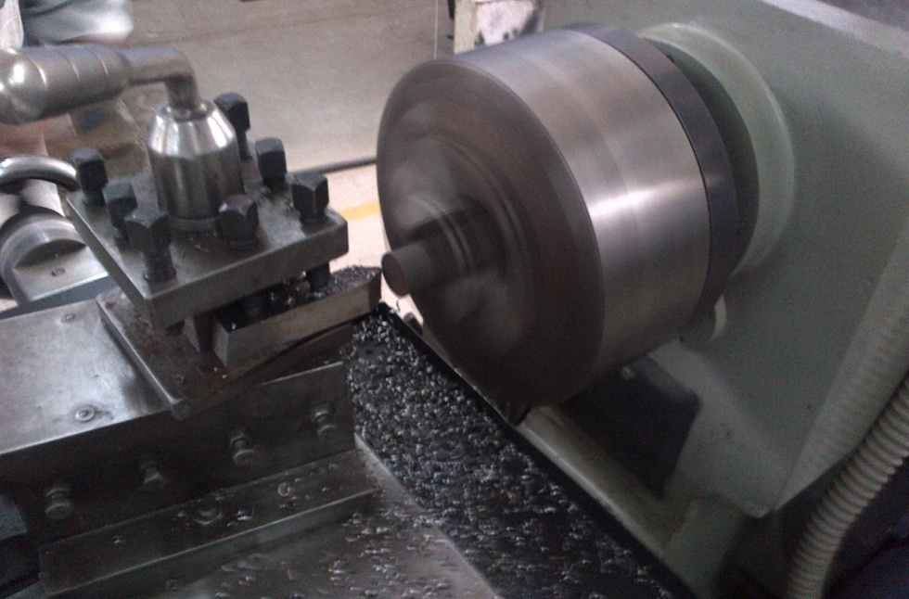
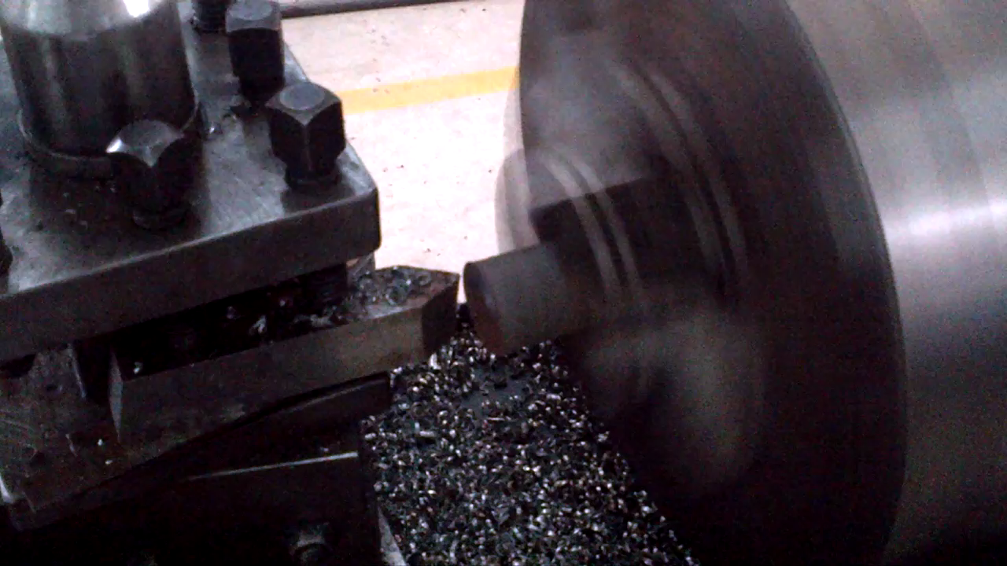
Facing

Slide 31
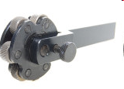
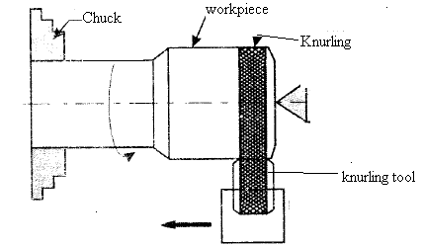
Lathe Operations - Knurling
Operation performed on lathe to generate serrated surface.
Tool used is called as “knurling tool”.
Tool consist of one upper roller and one lower roller which contains the impression.
Tool is set in such a way that both rollers touch the work.
Notes:
Serrated surface, visually attractive criss cross pattern
In the operation the lathe is set so that the workpiece revolves at a slow speed.
The knurling tool pressed against the rotating workpiece and pressure is slowly increased until the tool produces a pattern on the workpiece.
A variety of knurling patterns can be produced like angle pattern, diamond pattern, straight pattern.
This pattern gives grips to human hand to hold an object.

Slide 32
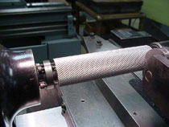
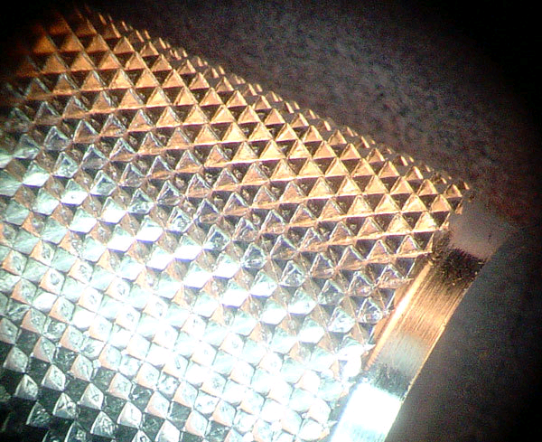
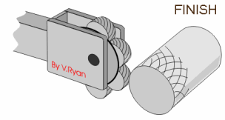
KNURLING – Operation of cutting a diamond shaped or a criss – cross pattern on metallic surfaces to provide better grip.

Slide 33
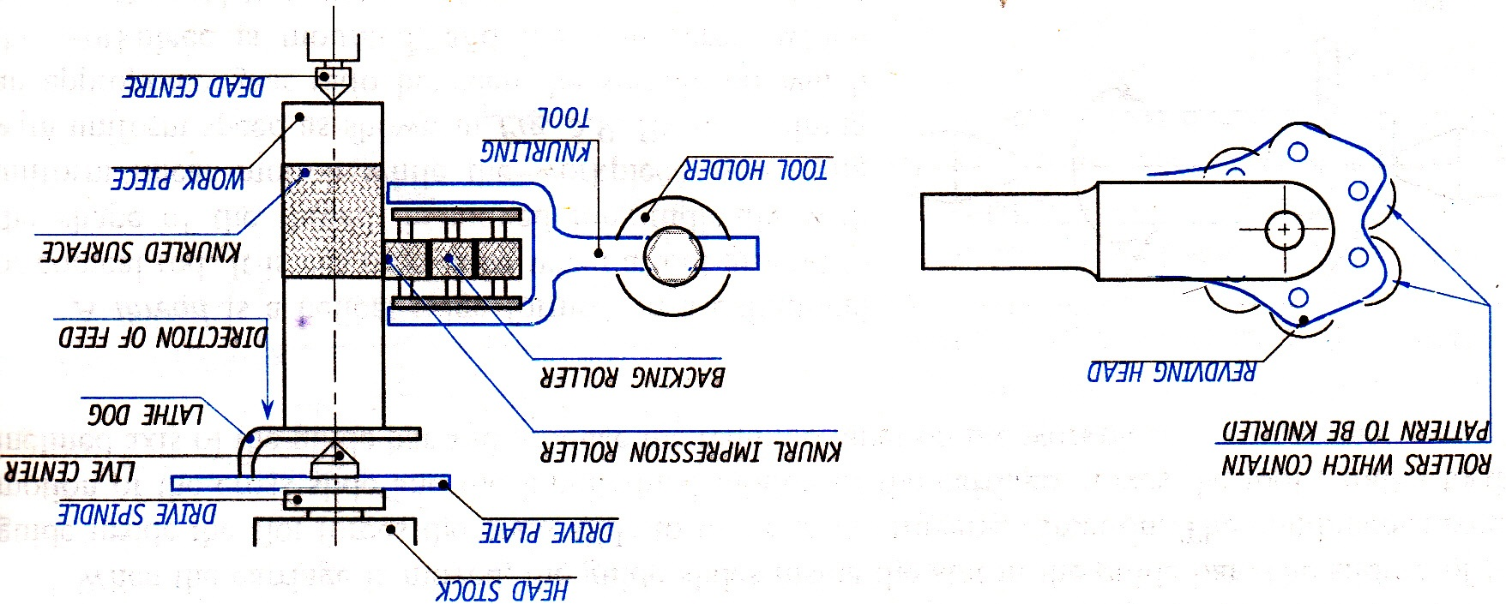
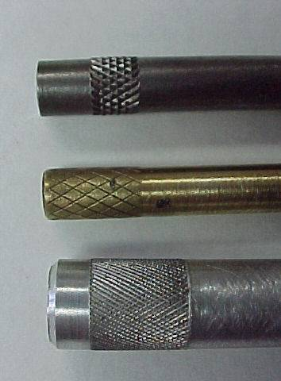
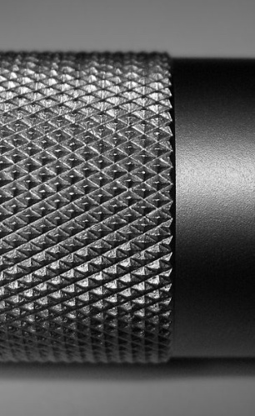
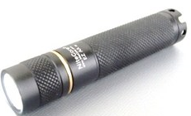
Lathe Operations - Knurling

Slide 34
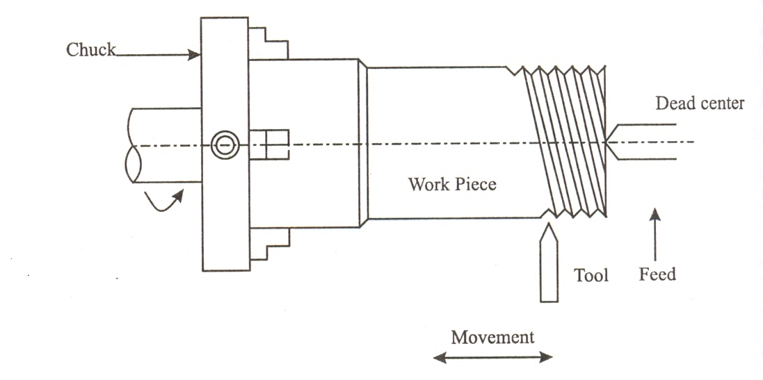
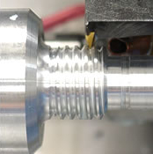
Lathe Operations - Thread cutting
A thread is a helical shaped groove formed on cylindrical surface of workpiece.
Thread cutting is an operation performed on lathe to produce threads by using a tool whose shape will be same as that of thread.
Notes:
Threading is a operation for cutting screw threads on metallic parts.
In operation a suitable tool which gives the required thread profile is mounted on the tool post. ( Eg. V thread, Square thread)
The workpiece is made to revolve at very slow speed.
The depth of cut is selected and the tool is made to move parallel to the lathe axis by means of automatic arrangement

Slide 35
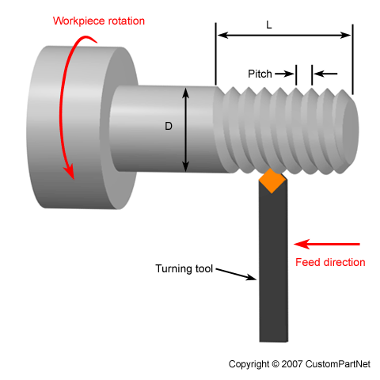
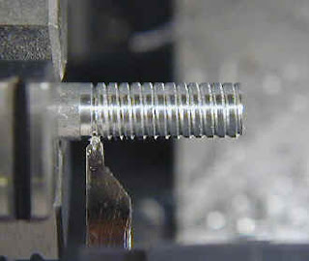
THREAD CUTTING – Operation for cutting screw threads on metallic parts.

Slide 36
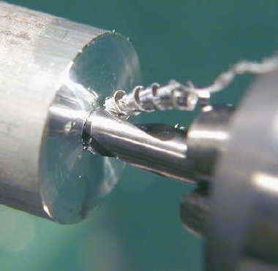
DRILLING – Operation of producing a cylindrical whole by means of revolving tool called ‘twist drill’.

Slide 37
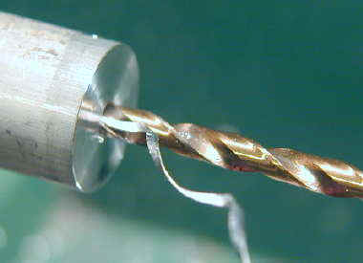
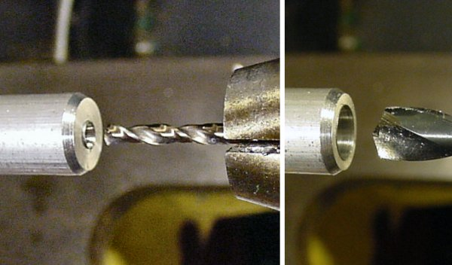

Slide 38
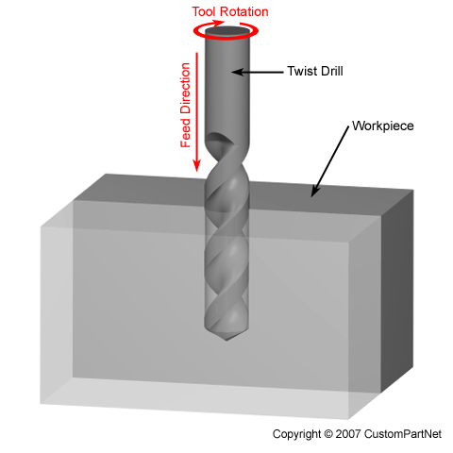
Drilling machines
Drilling is the operation of producing a cylindrical hole in a solid work piece by means of a revolving tool called drill bit.
Types of drilling machines
Portable DM
Bench DM
Radial DM
Multi spindle DM
Automatic DM
Gang DM

Slide 39
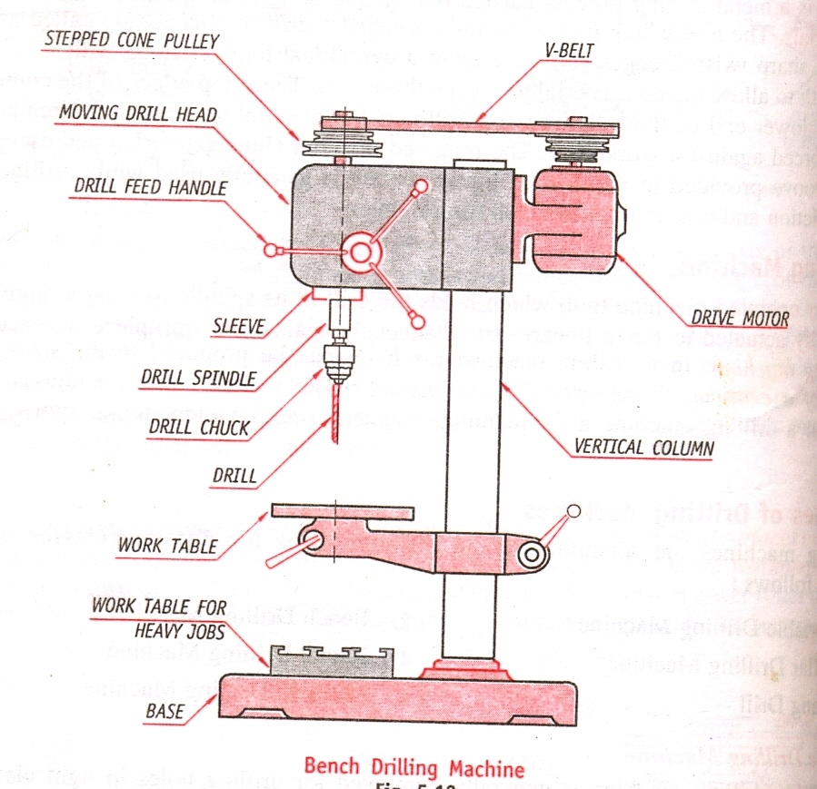
Drilling Machines:
A power operated machine tool, which holds the drill in its rotating spindle and produces a hole when moved linearly against the work piece.
Notes:
Drilling is a machining operation for producing a cylindrical hole in a solid workpiece by means of a revolving tool called drill bit.
The tool is also called as twist drill since it has sharp twisted edge formed around a cylindrical body.
In the operation the drill bit is held rigidly in the chuck of the machine and rotated by the spindle at high speed.
The rotating drill bit is forced to move against the rigid clamped workpiece.
The hole is generated by a sharp cutting edges of drill bit and mean while the excess material removed ( chips ) gets curled and escapes through the helical grooves provided in the drill bit

Slide 40
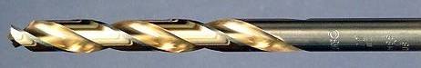
Principle of Drilling :
Drilling is the operation of making holes in a work piece using drill bit.
Tool used – Twist Drill.
Consist of helical groove (flute) along the length of the tool.
The stationary work is held in a fixture and the rotating tool is fed vertically down.
Removes the material, layer by layer.
Chips get curled and escape through the groove
Notes:
The tool is also called as twist drill since it has sharp twisted edge formed around a cylindrical body.

Slide 41
Principle of Drilling:
Work piece with the exact location marked on it with the centre punch is clamped rigidly on the work table.
spindle axis and center punch indentation are in same line.
Machine is started and drill bit is lowered by rotating feed handle.
Drill bit touches the work and starts removing material.

Slide 42



Drill bit Nomenclature

Slide 43



Portable Drilling machine
Notes:
Employed for drilling light classes of works such as structural fabrication, fitting work in assemblies and in cases where high accuracy is nor required. Drill hole up to 12mm. Used to produce small holes for short depths

Slide 44

Bench Drilling Machine
Step Cone pulley M/s
Drill Head
Hand feed Leaver
Diameter ranges from 1.5mm – 15.5mm
Chuck
Spindle
Vertical Column
Table with T-Slots
Base
Notes:
Used in small workshops
Placed on work bench

Slide 45
Construction
Base- Made up of cast iron and supports the vertical column and provided with holes to secure it tightly on table, bench or floor
Vertical column- Hollow steel pipe mounted rigidly on the base and supports drill head and worktable.
Worktable- Supports the work piece to be drilled and is provided with T-Slots to clamp the work piece rigidly on the table
Drill head- Located at top end of the vertical column carries an electric motor and a mechanism through which the spindle can me made to rotate and slide up and down

Slide 46

Radial drilling Machine
Elevating Motor
Elevating Screw
Spindle Motor
Drill Head
Guide ways
Vertical Column
Radial Arm
Diameter ranges from 15mm + depending upon size of hole to be drilled
Spindle
Table with T-Slots
Base
Notes:
Heavy workpiece
Heavy base, vertical column, horizonta arm

Slide 47

Multi spindle drilling Machine
Notes:
Drilling of several holes of diff dia

Slide 48

Automatic Drilling Machine

Slide 49

Gang Drilling Machine
Notes:
Diff types of toll with multiple drilling heads

Slide 50
Drilling Machine Operations
A part from drilling, a number of other operations that can be performed on a drilling machine are:
Boring
Counter boring
Counter sinking
Spot facing
Tapping
Reaming

Slide 51

Boring:
Done on a drilling machine to increase the size of an already drilled hole.
This method is done when suitable size drill is not available.
Initially a hole is drilled to the nearest size.
Using a single point cutting tool, the size of the hole is increased to required size

Slide 52

Counter Boring
It is to increase the size of a hole at one end only through a small depth.
It forms a larger sized shoulder to the existing hole.
The cutting tool will have a small cylindrical projection known as Pilot, which guides the tool.

Slide 53



Counter Sinking
It is the operation of making the end of the hole into a conical shape.

Slide 54


Spot Facing:
It is a finishing operation to produce flat round surface usually around a drilled hole, for proper seating of bolt head or nut.
It is done using a special spot facing tool.

Slide 55


Tapping:
Process of cutting internal threads with a thread tool called as tap.
Tap is a fluted threaded tool used for cutting internal thread.
Cutting speed is very slow.

Slide 56


Reaming:
It is a process of smoothing the surface of drilled holes with a tool.
Tool is called as reamer.
Initially a hole is drilled slightly smaller in size.
Drill is replaced by reamer.
Speed is reduced to half that of the drilling.

Slide 57



Introduction
Milling is a metal cutting operation in which the work is progressively moved towards a rotating cutter for material removal process.
Milling cutter is a multipoint cutting tool.

Slide 58
Milling machine
A milling machine is a power operated machine tool in which the work piece is mounted on moving table and is machined to various shapes when moved under a slow revolving cutter.
Work piece is fed against a milling cutter.
Metal is removed in the form of chips by using a rotating multiple teeth milling cutter.
Milling process is used for producing flat, helical surfaces for gears etc.

Slide 59
Principle of milling
The workpiece is mounted on the table can be fed either in the direction opposite to that of rotating cutter or in the same direction of the cutter.
Classification
Conventional or up milling.
Climb or down milling.

Slide 60
Classification
Milling machine can be broadly classified into:
Plain or horizontal type of milling machine
Vertical milling machine
Universal milling machine
Planer type milling machine
Profile cutting milling machine

Slide 61

Milling
Up Milling
Down Milling
The work piece mounted on the table can be fed either in the direction opposite to that of rotating cutter or in the same direction of that of cutter.
Notes:
Direction of Cutter Rotation
a. Up Cut Milling
In up cut milling, the cutter rotates in a direction opposite to the table feed as illustrated in figure 1. It is conventionally used in most milling operations because the backlash between the leadscrew and the nut of the machine table can be eliminated.
b. Down Cut Milling
In down cut milling, the cutter rotates in the same direction as the table feed as illustrated in figure 2. This method is also known as Climb Milling and can only be used on machines equipped with a backlash eliminator or on a CNC milling machine. This method, when properly treated, will require less power in feeding the table and give a better surface finish on the workpiece.
If you move the wrong direction, you may break the cutter as shown.

Slide 62

Horizontal Milling

Slide 63
Lathe Operations – Drilling
Drilling is an operation to produce a cylindrical hole in workpiece.
Tool used is called as “drill bit”.
Tool is held on the tailstock and stationary.
Work is held in chuck.
Tool is fed against the revolving work by rotating hand wheel.

Slide 64


Lathe Operations – Drilling

Slide 65

Plain Milling
Plain milling is the milling of a flat surface with the axis of the cutter parallel to the machining surface. It can be carried out either on a horizontal machine or a vertical machine as shown in figure
Notes:
It is also called as slab milling or surface milling. Which is used to produce plain surfaces with the milling cutter whose axis is parallel to the surface of workpiece being machined.
The cutter is called as plain or slab milling cutter which will be mounted on arbor to carry out the operation
It can use either straight or helical milling cutter. Helical removes more metal

Slide 66


End Milling
Notes:
End Milling is the milling of a flat surface, slots, edges of workpiece with the help of end milling cutter. the axis of the cutter perpendicular to the machining surface as shown in figure
Tool used is end mill tool. The cutter having the tooth at the end as well as at the side (periphery). Hence it can cut both end and sides of workpiece. Here also u can use straight ( both hard and soft materials) or spiral flutes( cutting steel)
It can use horizontal or vertical milling machine

Slide 67

Slot Milling
Notes:
Slot milling is the operation of producing various types of slots like T slots, plain slots, dovetail slots etc.
The type of cutter selected depends on the shape of the slot to be produced.
Two separate milling cutters are used, first side cutter or end milling cutter are used to cut the throat next T slot cutter is used to cut the head space.
A T slot cutter is then used to cut the head space to desired dimensions.

Slide 68

Angular Milling
Notes:
To produce dovetail the dovetail cutter is used instead of T slot cutter. It is used to produce flat surfaces which are neighter paralller or perpendicular. Grooves, chamfers are done through this operations

Slide 69

Form Milling
Notes:
It is used to machine countours consisting of curves with a help of a tool called form milling cutter
The shape of the tool must be contour that is to be form milled

Slide 70


Straddle Milling
Notes:
Straddle MillingIn straddle milling, a group of spacers is mounted in between two side and face milling cutters on the spindle arbor as shown in figure. for the milling of two surfaces parallel to each other at a given distance.
it is use to machine two or more parallel surfaces at a single time by mounting two side milling cutters on the same arbor seperated by some distance

Slide 71


Gang Milling
Notes:
Gang Milling Gang milling is a horizontal milling operation that utilises three or more milling cutters grouped together for the milling of a complex surface in one pass. As illustrated in figure, different type and size of cutters should be selected for achieving the desire profile on the workpiece.

Slide 72
Computer Numerical Control
Advances in computer technology over the years have resulted in smaller less costly yet more powerful computer.
In NC the result of this trend toward miniaturization was that it became economical for one computer to be used to control each machine tool.
This new configuration came to be called computer numerical control .
Notes:
CNC is an advanced form of NC system where the machine control unit is a dedicated microcomputer instead of a hard- wired controller, as in conventional NC
CNC has evolved during the rapid improvements of the computer technology. The advent of microprocessors from 1970s have helped in quick advancements in the computer technology and is in turn adapted in modren CNC technology.

Slide 73
Elements of CNC
Any CNC system consists of following elements:
Part program
Program input device
Machine control unit
Drive system
Machine tool
Feedback system

Slide 74

Notes:
Actuators : the adjustments made in the process are actuated by hardware devices called actuators that uses hardware devices like motor, valve to physically control the actions.
The part program is entered into the MCU through input device.

Slide 75

Notes:
The set of actions that is accomplished by an automated system are determined by the program of instructions.
The path program is input the NCN control or MCU through the IP device
MCU –> DPU + CLU
MCU is heart the CNC system

Slide 76

.
Notes:
Liner interpolation – generate the axis of command.

Slide 77

.
Notes:
The part program is entered into the MCU through input device.
Diskette : an floppy disk ; A small, flexible magnetic disk for storage and retrieval of data.
RS 232 serial ports : A communication port connected to a computer system and CNC machine tool through an interface called RS-232. Most machines have RS-232 port and RS-232 cable connects a computer and CNC machine to transfer data from the computer to CNC machine
Ethernet cable connection or Ethernet communication is also used

Slide 78

.
Notes:
Feed back signal : Compares the output value with input value.

Slide 79

.

Slide 80

.

Slide 81

.

Slide 82
ADVANTAGESOF CNC
High Repeatability and Precision, e.g. Aircraft parts.
Volume of production is very high.
Complex contours/surfaces can be machined
Flexibility in job change, automatic tool settings, less scrap.
Safer, better quality.
Easier to program.
Easy storage of existing programs.
Avoids human errors.
Usually generates closer tolerances than manual machines.
Program editing at the machine tool.

Slide 83
DISADVANTAGES
Costly setup.
Computers, programming knowledge required.
Maintenance is difficult.
Machines have to be installed in air conditioned places.

